Slide 1
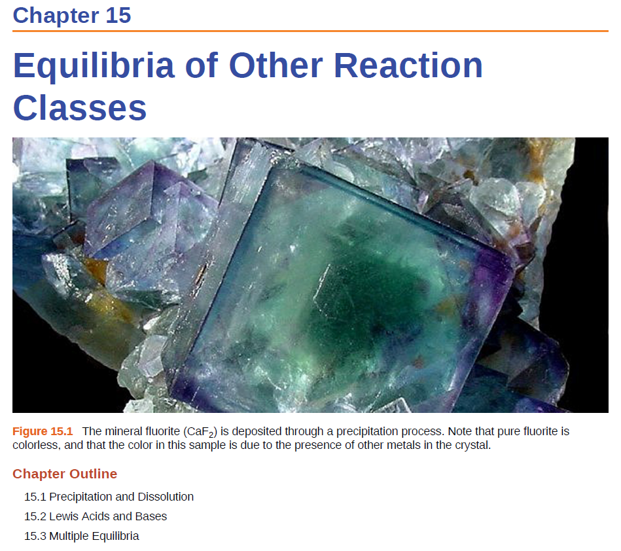
Solubility Product
K_{sp} and Solubility
Predicting Precipitation
Common Ion Effect

Slide 2
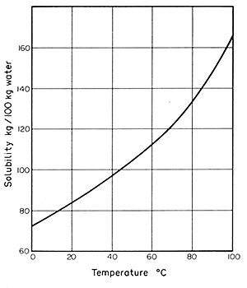
Chapter 11
The relationship between solubility and temperature can be represented by a solubility curve.
Each point in the solubility curve represents a saturated solution.
Any point below a curve represents an unsaturated solution.
Any point above the curve would be a super saturated solution.
Super saturated
Saturated
Unsaturated

Slide 3
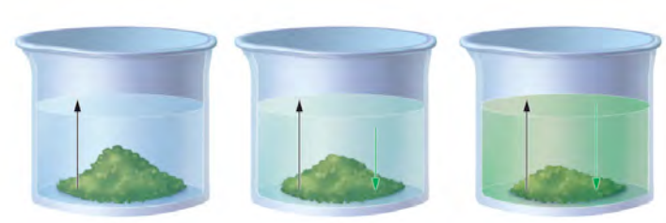
Chapter 15
The change is reversible
The system is “closed”—no substance can enter or leave
The system is dynamic - At the macroscopic level, it appears as if nothing is happening, but at the particulate level, reversible changes are occurring continuously.
Can be at physical equilibrium or chemical equilibrium
A B
Physical Equilibrium- forward and reverse processes occur at the same rate but there is no chemical change.
Solubility
At time = 0
At time > 0
At time = ∞
rate of dissolution
rate of precipitation
=

Slide 4
Solubility
Salts are usually strong electrolytes:
NaCl(s) ⎯→ Na⁺(aq) + Cl–(aq)
They dissolve in water forming hydrated ions until a saturated solution is formed.
In the saturated solution, there exists a dynamic equilibrium between the solid salt and dissolved ions.
Some salts, however, are only sparingly soluble:
AgCl(s) Ag⁺(aq) + Cl–(aq)
Only a small amount of such a salt is required to produce a saturated solution.

Slide 5
Solubility Product
AgCl(s) Ag⁺(aq) + Cl–(aq)
At equilibrium the rate of dissolution equals the rate of precipitation and an equilibrium expression can be written:
K_{c} =
[Ag⁺][Cl⁻]
= K_{sp}
K_{sp} is the solubility product constant
The smaller the solubility product, the less soluble is the salt.
The larger the solubility product, the more soluble is the salt.
If two compounds have the same ion ratio, the one with the larger K_{sp} will have the higher molar solubility.

Slide 6
Solubility Product
For a general dissolution/precipitation equilibrium such as:
A_{a}B_{b}(s) aA (aq) + bB (aq)
K_{sp} =
[A]ª
[B]^{b}
K_{sp} is the solubility product constant
AgCl (s) Ag⁺ (aq) + Cl⁻ (aq)
K_{sp} = [Ag⁺][Cl⁻]
MgF₂ (s) Mg²⁺ (aq) + 2F⁻ (aq)
K_{sp} = [Mg²⁺][F⁻]²
Ag₂CO₃ (s) 2Ag⁺ (aq) + CO₃²⁻ (aq)
K_{sp} = [Ag⁺]²[CO₃²⁻]
Ca₃(PO₄)₂ (s) 3Ca²⁺ (aq) + 2PO₄³⁻ (aq)
K_{sp} = [Ca²⁺]³[PO₄³⁻]²

Slide 7
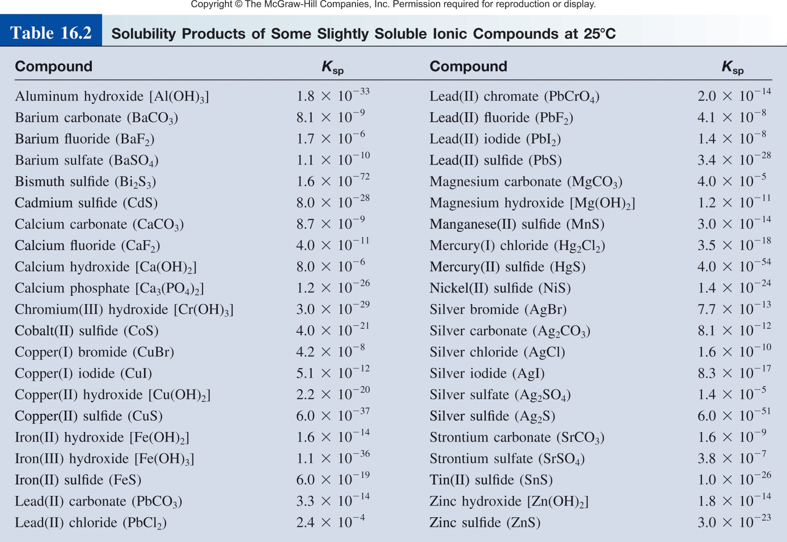
Solubility Product
Range from very small (10⁻⁷² for Bi₂S₃) to very large (NaCl).
K_{sp}
Solubility

Slide 8

Solubility Product
K_{sp} and Solubility
Predicting Precipitation
Common Ion Effect

Slide 9
Solubility
There are two other ways to express a substance’s solubility:
Molar solubility (mol/L) is the number of moles of solute dissolved in 1 L of a saturated solution.
Solubility (g/L) is the number of grams of solute dissolved in 1 L of a saturated solution.
Molar solubility
Molar solubility
Solubility
Solubility
mol
g
g
g
mol
mol
x
=
x
=
L
mol
L
L
g
L
Molar Mass
1/Molar Mass

Slide 10
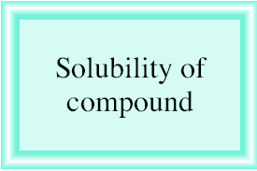
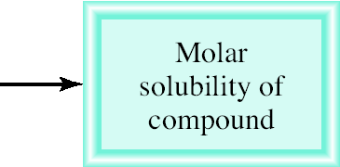
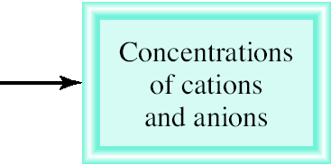
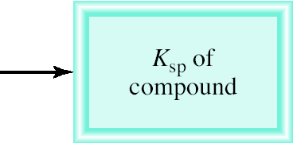
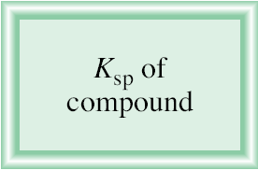
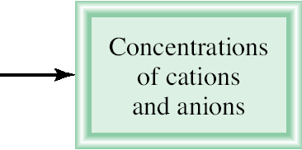
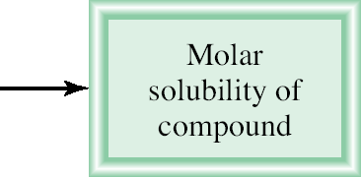
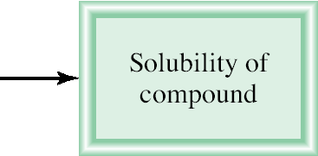
Relating Solubility Descriptions
K_{sp} is the solubility product constant
Molar solubility (mol/L)
Solubility (g/L)

Slide 11
The solubility of calcium sulfate (CaSO₄) is found to be 0.67 g/L. Calculate the value of K_{sp} for calcium sulfate.
CaSO₄(s) Ca²⁺ (aq) + SO₄²⁻ (aq)
given
K_{sp} = [Ca²⁺][SO₄²⁻]
?
solubility of molar solubility [Ca²⁺] and K_{sp} of
CaSO₄ in g/L of CaSO₄ [SO₄²⁻] CaSO₄
[Ca²⁺] = 4.9 x 10⁻³ M and [SO₄²⁻] = 4.9 x 10⁻³ M
K_{sp} = [Ca²⁺][SO₄²⁻]
= (4.9 x 10⁻³)(4.9 x 10⁻³) = 2.4 x 10⁻⁵

Slide 12


K_{sp} to molar solubility
K_{sp} = 7.7 x 10⁻¹³ M
K_{sp} = [Ag⁺] [Br⁻]
s = molar solubility

Slide 13
How many grams of copper(II) hydroxide, Cu(OH)₂ (K_{sp} = 2.2 x 10⁻²⁰ M ), will dissolve in 1 L of water.
K_{sp} of [Cu²⁺] and molar solubility solubility of
Cu(OH)₂ [OH⁻] of Cu(OH)₂ Cu(OH)₂ in g/L
K_{sp} = [Cu²⁺][OH⁻]²
= (s)(2s)² = 4s³
 | Cu(OH)₂(s) |  | Cu²⁺(aq) + | 2OH⁻(aq)
Initial (M): |  |  | 0 | 0
Change (M):
Equilibrium (M):
-s
+s
+2s
s
2s

Slide 14
How many grams of copper(II) hydroxide, Cu(OH)₂ (K_{sp} = 2.2 x 10⁻²⁰ M ), will dissolve in 1 L of water.
s = 1.8 x 10⁻⁷ M
K_{sp} of [Cu²⁺] and molar solubility solubility of
Cu(OH)₂ [OH⁻] of Cu(OH)₂ Cu(OH)₂ in g/L
K_{sp} = [Cu²⁺][OH⁻]²
= (s)(2s)² = 4s³

Slide 15
How many grams of copper(II) hydroxide, Cu(OH)₂ (K_{sp} = 2.2 x 10⁻²⁰ M ), will dissolve in 1 L of water.
s = 1.8 x 10⁻⁷ M
K_{sp} of [Cu²⁺] and molar solubility solubility of
Cu(OH)₂ [OH⁻] of Cu(OH)₂ Cu(OH)₂ in g/L

Slide 16
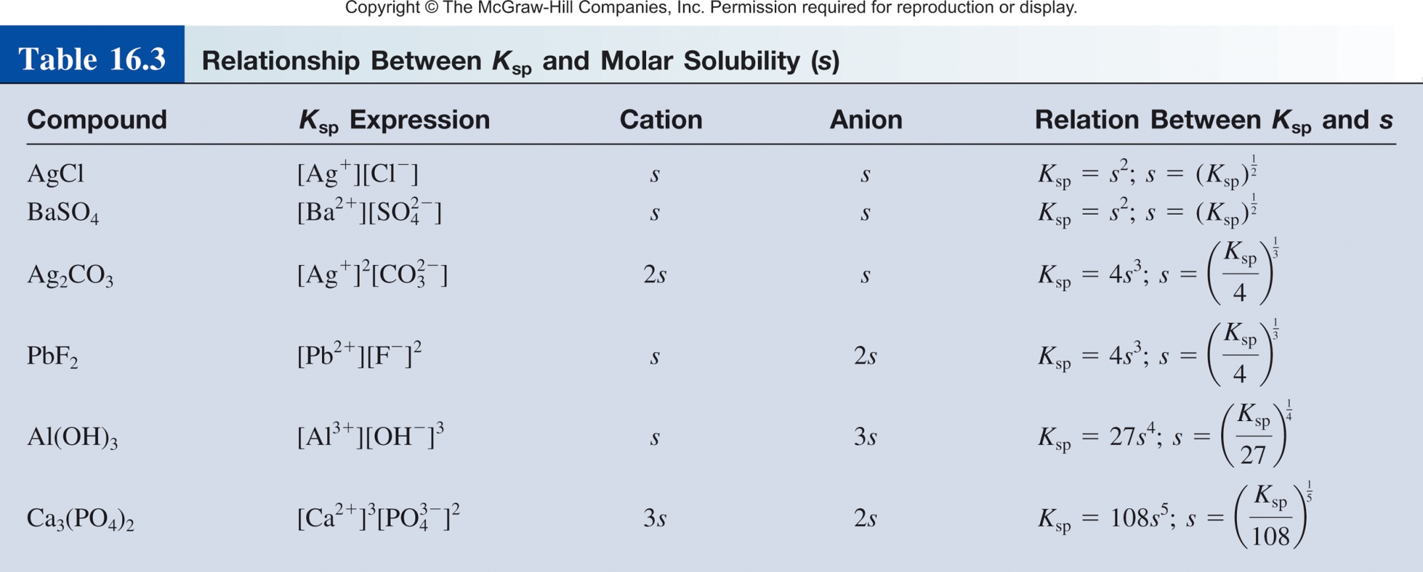
Relationship between K_{sp} and molar solubility
What else can we learn from K_{sp}?

Slide 17
Solubility Product
K_{sp} and Solubility
Predicting Precipitation
Common Ion Effect

Slide 18
Predicting Precipitation Reactions
A_{a}B_{b}(s) aA (aq) + bB (aq)
The ion product Q has the same form as the equilibrium constant K.
Q is not necessarily at equilibrium, typically initial conditions.
Allows us to predict if a precipitate will form.
K_{sp} =
[A]ª
[B]^{b}
K_{sp} is the solubility product constant
Q =
[A]ª
[B]^{b}
Q is the ion product
Q < K_{sp}
Unsaturated solution
No precipitate
Q = K_{sp}
Saturated solution
Q > K_{sp}
Supersaturated solution
Precipitate will form

Slide 19
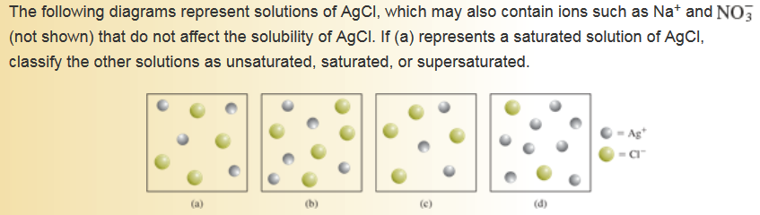
Predicting Precipitation Reactions
Q = [Ag⁺][Cl⁻]
K_{sp} = [Ag⁺][Cl⁻]
Q < K_{sp}
Unsaturated solution
Q = K_{sp}
Saturated solution
Q > K_{sp}
Supersaturated solution

Slide 20
Exactly 200 mL of 0.0040 M BaCl₂ are mixed with exactly
600 mL of 0.0080 M K₂SO₄. Will a precipitate form?
BaCl₂(s) Ba²⁺ (aq) + 2Cl⁻ (aq)
K₂SO₄(s) 2K⁺ (aq) + SO₄⁻² (aq)
200 mL of 0.004 M BaCl₂
600 mL of 0.008 M BaCl₂
Ba²⁺
K⁺
Cl⁻
Cl⁻
K⁺
SO₄⁻²
Will a precipitate form?
SO₄⁻²
K⁺
KCl
or
BaSO₄
800 mL
Ba²⁺
K⁺
Cl⁻
Cl⁻

Slide 21
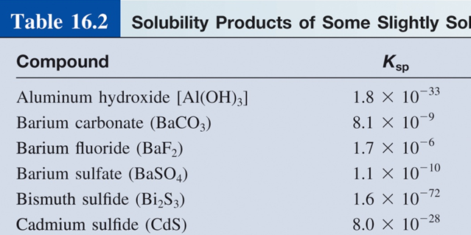
Exactly 200 mL of 0.0040 M BaCl₂ are mixed with exactly
600 mL of 0.0080 M K₂SO₄. Will a precipitate form?
Need to know K_{sp} and Q?
SO₄⁻²
Q < K_{sp}
K⁺
No precipitate
Ba²⁺
Q = K_{sp}
K⁺
Cl⁻
Cl⁻
Q > K_{sp}
Precipitate will form
Ba(SO₄)₂
Ba⁺ (aq) + SO₄⁻² (aq)
Q = [Ba²⁺][SO₄⁻²]
Need to find

Slide 22
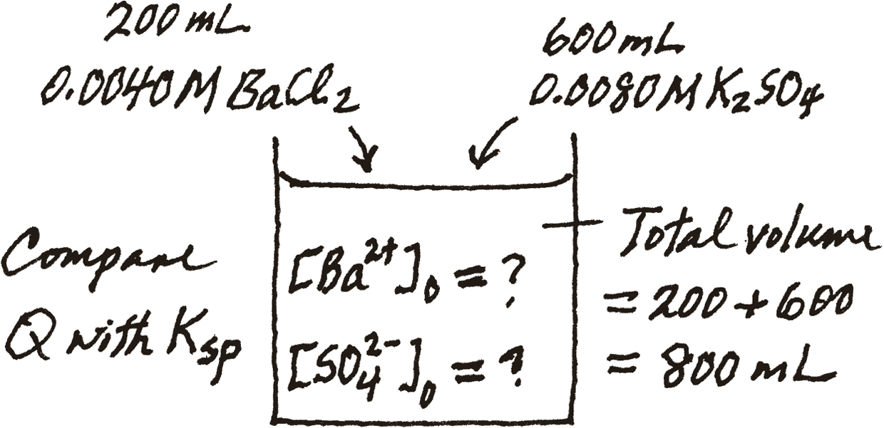
Exactly 200 mL of 0.0040 M BaCl₂ are mixed with exactly
600 mL of 0.0080 M K₂SO₄. Will a precipitate form?
Q = [Ba²⁺][SO₄⁻²]
BaCl₂(s) Ba²⁺(aq) + 2Cl⁻(aq)
K₂SO₄(s) 2K⁺(aq) + SO₄⁻²(aq)
200 mL of 0.004 M BaCl₂
600 mL of 0.008 M K₂SO₄

Slide 23
Exactly 200 mL of 0.0040 M BaCl₂ are mixed with exactly
600 mL of 0.0080 M K₂SO₄. Will a precipitate form?
Q = [Ba²⁺][SO₄⁻²]
BaCl₂(s) Ba²⁺(aq) + 2Cl⁻(aq)
K₂SO₄(s) 2K⁺(aq) + SO₄⁻(aq)
200 mL of 0.004 M BaCl₂
600 mL of 0.008 M BaCl₂

Slide 24
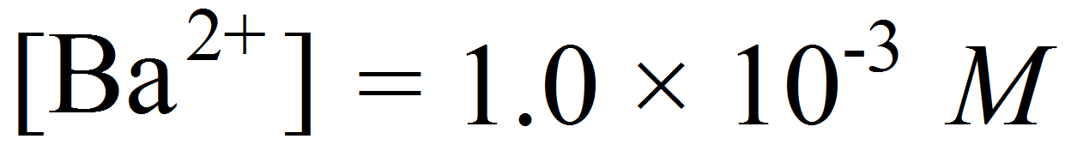
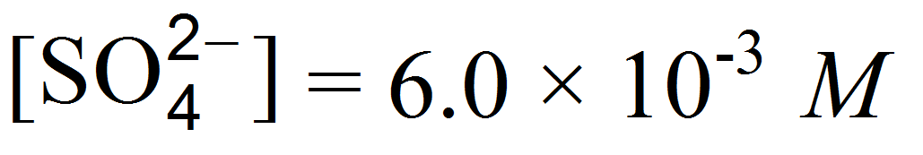
Exactly 200 mL of 0.0040 M BaCl₂ are mixed with exactly
600 mL of 0.0080 M K₂SO₄. Will a precipitate form?
Ba(SO₄)₂
Ba⁺ (aq) + SO₄⁻² (aq)
K_{sp} = 1.1 x 10⁻¹⁰
Q = [Ba²⁺][SO₄⁻²]
Q = (1.0 x 10⁻³)(6.0 x 10⁻³) = 6.0 x 10⁻⁶
Q > K_{sp}
Precipitate will form.

Slide 25
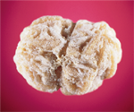
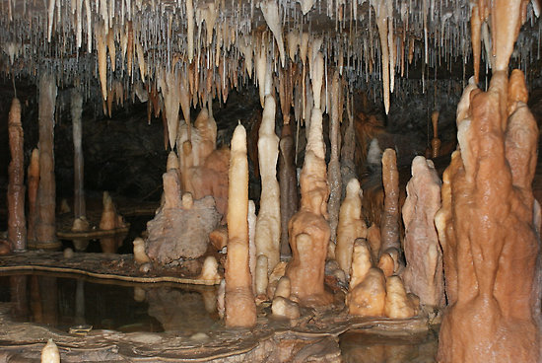
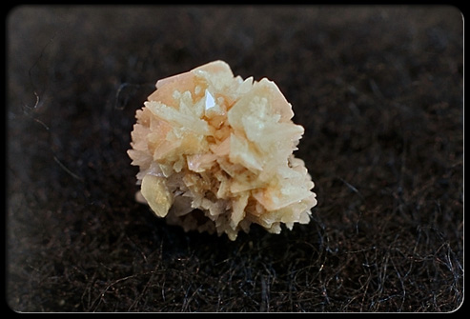
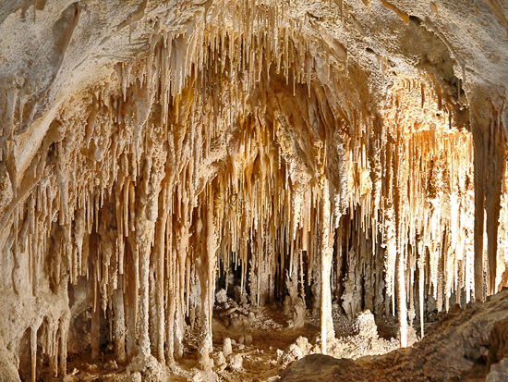
Side note: Precipitation Reactions
Type of kidney stones
1.Calcium stones (80% of all kidney stones)
-Calcium oxalate (K_{sp} = 2.3 x 10⁻⁹)
-Calcium phosphate (K_{sp} = 1.2 x 10⁻²⁶)
2.Uric acid stones
3.Struvite stones (Mg²⁺, NH⁴⁺, Ca²⁺ and PO₄³⁻)

Slide 26
Solubility Product
K_{sp} and Solubility
Predicting Precipitation
Common Ion Effect

Slide 27
Common Ion Effect and pH
The common ion effect is the shift in equilibrium caused by the addition of a compound having an ion in common with the dissolved substance.
Specific case of LCP
CH₃COOH (aq) H⁺ (aq) + CH₃COO⁻ (aq)
Then we add some CH₃COONa (a strong electrolyte).
common ion
CH₃COONa (s) Na⁺ (aq) + CH₃COO⁻(aq)
The presence of a common ion suppresses the ionization of a weak acid or a weak base. It will influence the pH.

Slide 28

Common Ion Effect and Solubility
The common ion effect is the shift in equilibrium caused by the addition of a compound having an ion in common with the dissolved substance.
Specific case of LCP
common ion
Add AgNO₃
Cl⁻
Ag⁺
Ag⁺
Cl⁻
AgCl
More precipitate will form as we add AgNO₃.
The presence of a common ion decreases the solubility of the salt.

Slide 29
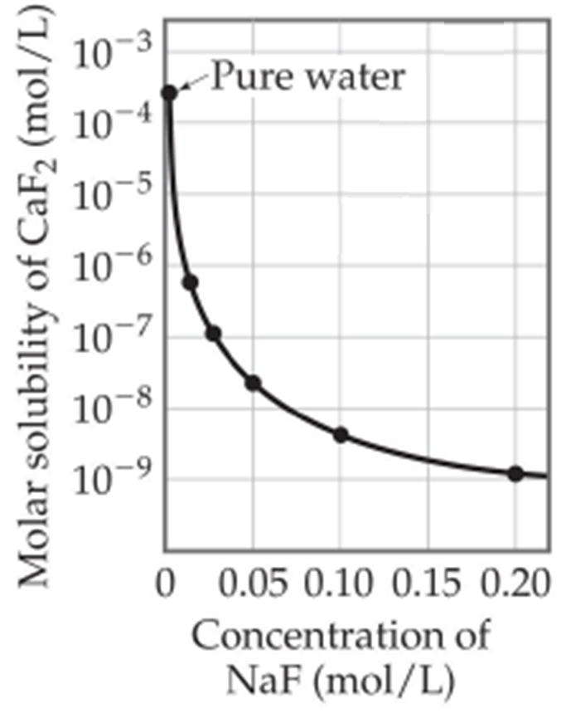
Common Ion Effect and Solubility
The common ion effect is the shift in equilibrium caused by the addition of a compound having an ion in common with the dissolved substance.
Specific case of LCP
Add NaF
CaF₂(s) Ca²⁺(aq) + F⁻(aq)
F⁻
Ca²⁺
NaF (s) Na⁺(aq) + F⁻(aq)
Ca²⁺
F⁻
CaF₂

Slide 30
Common Ion Effect and Solubility
The common ion effect is the shift in equilibrium caused by the addition of a compound having an ion in common with the dissolved substance.
Specific case of LCP
Add NaF
CaF₂(s) Ca²⁺(aq) + F⁻(aq)
F⁻
Ca²⁺
NaF (s) Na⁺(aq) + F⁻(aq)
Ca²⁺
F⁻
CaF₂
Salts become increasingly less soluble when more common ion is added.

Slide 31
Calculate the solubility of silver chloride (in g/L) in a 6.5 x 10⁻³ M silver nitrate solution. (AgCl, K_{sp} = 1.6 x 10⁻¹⁰)
First lets calculate the solubility of AgCl (in g/L):
K_{sp} of [Ag⁺] and molar solubility solubility of
AgCl [Cl⁻] of AgCl AgCl in g/L
K_{sp} = [Ag⁺][Cl⁻]
= (s)(s) = s²
= 1.6 x 10⁻¹⁰
 | AgCl(s) |  | Ag⁺(aq) + | Cl⁻(aq)
Initial (M): |  |  | 0 | 0
Change (M):
Equilibrium (M):
-s
+s
+s
s
s
K_{sp} = 1.6 x 10⁻¹⁰
s = 1.3 x 10⁻⁶ mol/L

Slide 32
Calculate the solubility of silver chloride (in g/L) in a 6.5 x 10⁻³ M silver nitrate solution. (AgCl, K_{sp} = 1.6 x 10⁻¹⁰)
First lets calculate the solubility of AgCl (in g/L):
K_{sp} of [Ag⁺] and molar solubility solubility of
AgCl [Cl⁻] of AgCl AgCl in g/L
1.3 x 10⁻⁶ mol/L
143.4 g/mol
1.8 x 10⁻³ g/L

Slide 33
Calculate the solubility of silver chloride (in g/L) in a 6.5 x 10⁻³ M silver nitrate solution. (AgCl, K_{sp} = 1.6 x 10⁻¹⁰)
First lets calculate the solubility of AgCl (in g/L):
1.8 x 10⁻³ g/L
What happens to this number is we are in a 6.5 x 10⁻³ M silver nitrate solution.
Solubility of AgCl will go down.
< 1.8 x 10⁻³ g/L
common ion

Slide 34
Calculate the solubility of silver chloride (in g/L) in a 6.5 x 10⁻³ M silver nitrate solution. (AgCl, K_{sp} = 1.6 x 10⁻¹⁰)
First lets calculate the solubility of AgCl (in g/L):
1.8 x 10⁻³ g/L
What happens to this number is we are in a 6.5 x 10⁻³ M silver nitrate solution.
6.5 x 10⁻³ M
6.5 x 10⁻³ M
 | AgCl(s) |  | Ag⁺(aq) + | Cl⁻(aq)
Initial (M):
Change (M):
Equilibrium (M):
6.5 x 10⁻³
0.00
-s
+s
+s
(6.5 x 10⁻³ +s)
s
K_{sp} = [Ag⁺][Cl⁻]
1.6 x 10⁻¹⁰ = (6.5 x 10⁻³ + s)(s)
s = 2.5 x 10⁻⁸ M

Slide 35
Calculate the solubility of silver chloride (in g/L) in a 6.5 x 10⁻³ M silver nitrate solution. (AgCl, K_{sp} = 1.6 x 10⁻¹⁰)
First lets calculate the solubility of AgCl (in g/L):
1.8 x 10⁻³ g/L
What happens to this number is we are in a 6.5 x 10⁻³ M silver nitrate solution.
molar solubility solubility of
of AgCl AgCl in g/L
2.5 x 10⁻⁸ M
143.4 g/mol
3.6 x 10⁻⁶ g/L
AgCl becomes less soluble when Ag⁺ is added.

Slide 36
Fractional Precipitation
Fractional precipitation is a method of precipitating some ions from solution while leaving others in solution.
If we want to separate gold we could add Cl⁻ ions.
Cu⁺
Ag⁺
Au⁺
SO₄²⁻
If solid sodium chloride is slowly added to a solution that is 0.010 M each in Cu⁺, Ag⁺, and Au⁺ ions, which compound precipitates first?
First AuCl then AgCl then CuCl

Slide 37
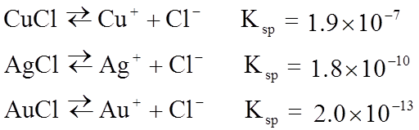
Fractional Precipitation
We can calculate the concentration of Cl⁻ required to initiate precipitation of each of these metal chlorides.
[Cl-] needed to precipitate
Cu⁺
Ag⁺
Au⁺
SO₄²⁻
>2.0 x 10⁻¹¹ M
0.010 M M⁺
We need to add a minimum of 2.0 x 10⁻¹¹ M Cl⁻ to begin to precipitate Au⁺.

Slide 38
Fractional Precipitation
We can calculate the concentration of Cl⁻ required to initiate precipitation of each of these metal chlorides.
[Cl-] needed to precipitate
Cu⁺
Ag⁺
>1.8 x 10⁻⁸ M
Au⁺
SO₄²⁻
>2.0 x 10⁻¹¹ M
0.010 M M⁺
We need to add a minimum of 1.8 x 10⁻⁸ M Cl⁻ to begin to precipitate Ag⁺.

Slide 39
Fractional Precipitation
We can calculate the concentration of Cl⁻ required to initiate precipitation of each of these metal chlorides.
[Cl-] needed to precipitate
>1.9 x 10⁻⁵ M
Cu⁺
Ag⁺
>1.8 x 10⁻⁸ M
Au⁺
SO₄²⁻
>2.0 x 10⁻¹¹ M
0.010 M M⁺
We need to add a minimum of 1.9 x 10⁻⁵ M Cl⁻ to begin to precipitate Cu⁺.

Slide 40
Fractional Precipitation
We can calculate the concentration of Cl⁻ required to initiate precipitation of each of these metal chlorides.
[Cl-] needed to precipitate
>1.9 x 10⁻⁵ M
Cu⁺
Ag⁺
>1.8 x 10⁻⁸ M
Au⁺
SO₄²⁻
>2.0 x 10⁻¹¹ M
0.010 M M⁺
What is the maximum Au⁺ we can precipitate without precipitating any Ag⁺?
Max amount of Cl⁻ we can add before Ag⁺ precipitates.

Slide 41
Fractional Precipitation
We can calculate the concentration of Cl⁻ required to initiate precipitation of each of these metal chlorides.
[Cl-] needed to precipitate
>2.0 x 10⁻¹¹ M
Cu⁺
Ag⁺
>1.8 x 10⁻⁸ M
Au⁺
SO₄²⁻
>1.9 x 10⁻⁵ M
0.010 M M⁺
What is the maximum Au⁺ we can precipitate without precipitating any Ag⁺?
Therefore, 99.99989% of the Au⁺ ions precipitates before AgCl begins to precipitate.

Slide 42
Definition
Complex Ions
K_{f} and K_{d}

Slide 43
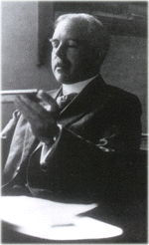
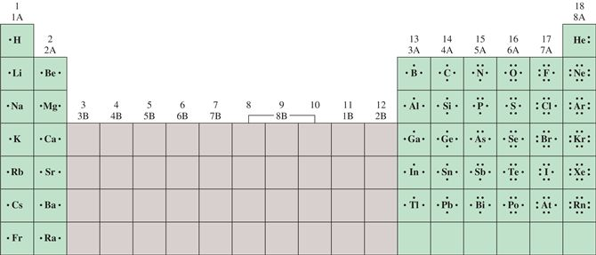
Lewis Acids and Bases
Lewis Dot Structure:
Need 1 electron each
Combine unpaired electrons
Needs 3 electrons
Gilbert Newton Lewis
(1875-1946)
Also proposed a definition for acids and bases. Now known as Lewis acids.

Slide 44
Lewis Acids and Bases
A Lewis base is any species that donates an electron pair.
An Lewis acid is any species that accepts an electron pair.
This definition greatly expands the classes of acids.
The acid-base reaction, in the Lewis sense, is the sharing of an electron pair between an acid and a base resulting in the formation of a bond:
A + :B ⎯→ A–B
F
H
F
H
F B
+
•
N H
F B
N H
•
F
H
F
H
Lewis acid
Lewis base
Acid-base adduct
No H⁺ or OH⁻ created. No protons donated or accepted!

Slide 45
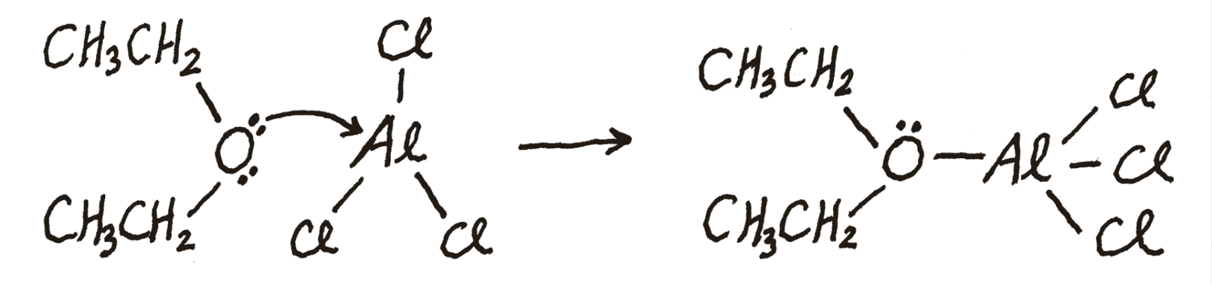
Identify the Lewis acid and Lewis base in each of the following reactions:
C₂H₅OC₂H₅ + AlCl₃ (C₂H₅)₂OAlCl₃
(b) Hg²⁺(aq) + 4CN⁻(aq) (aq)
base
acid
acid
base
Here the Hg²⁺ ion accepts four pairs of electrons from the CN⁻ ions.

Slide 46
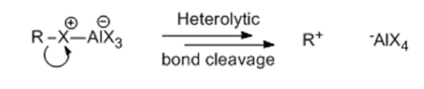
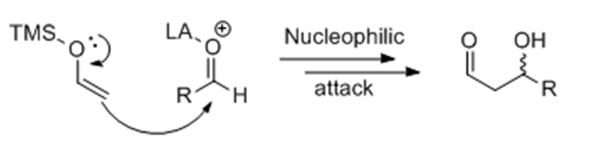
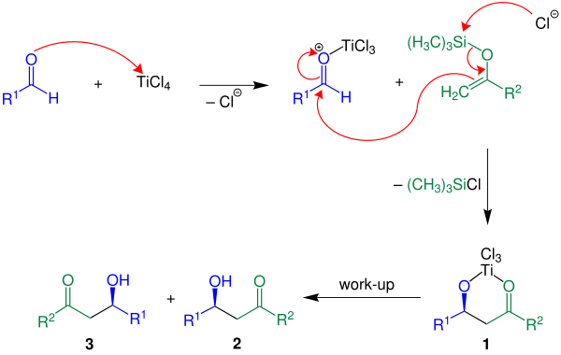
Lewis Acid/Base Reactions and Catalysis

Slide 47
Definition
Complex Ions
K_{f} and K_{d}

Slide 48
Complex Ions
Many metal ions (Lewis acid), especially transition metals, form coordinate covalent bonds with molecules or anions having a lone pair of electrons (Lewis base).
M
+
L

Slide 49
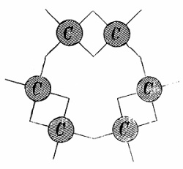
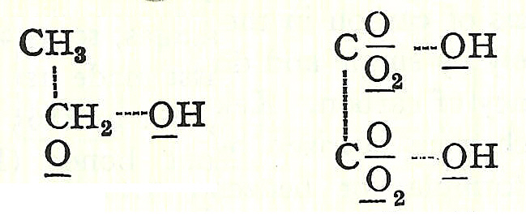
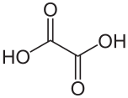

Organic Bonding Lewis Dot Structures
1857- Kekule proposes the correct structure of benzene.
1856- Couper proposed that atoms joined to each other like modern-day Tinkertoys.
Ethanol
Oxalic acid

Slide 50
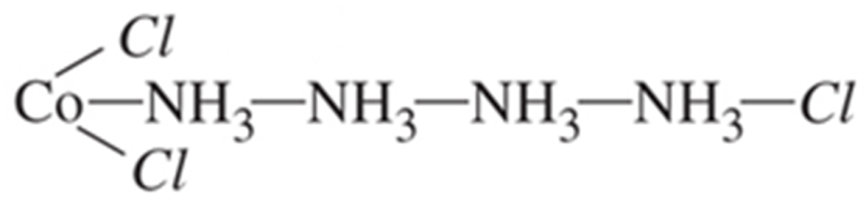
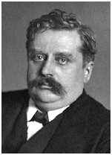

Inorganic Complexes
Co³⁺ + 4 x NH₃ + 3 x Cl
Late 1800s- Blomstrand and Jorgenson
Proposed structure:
1893- Werner’s Theory
Werner was awarded the Nobel Prize in 1913
(only inorg. up until 1973)
Lewis acid-base
coordination complex
Notes:
Precipitation and conductance

Slide 51
Complex Ion
Many metal ions (Lewis acid), especially transition metals, form coordinate covalent bonds with molecules or anions having a lone pair of electrons (Lewis base).
M
+
L
A complex ion is an ion containing a central metal cation bonded to one or more molecules or ions. Also known as a coordination complex.
The Lewis base (electron pair donor) that bonds to a metal ion to form a complex ion is also known as a Ligand.

Slide 52
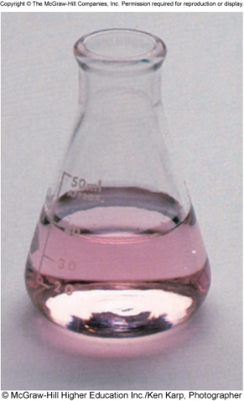
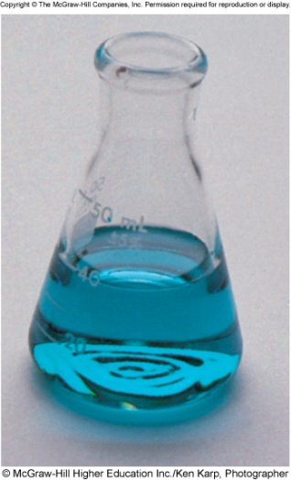
Complex Ion Equilibria
Formation constant (K_{f}), also known as the stability constant, is the equilibrium constant for the formation of a complex ion
Lewis acid
Complex Ion
2-
Co²⁺ (aq) + 4Cl⁻ (aq) CoCl₄ (aq)
Lewis base
Soluble
Co
2+
2-
CoCl₄
2-
[CoCl₄ ]
K_{f} =
[Co²⁺][Cl⁻]⁴
HCl
stability of complex
K_{f}

Slide 53
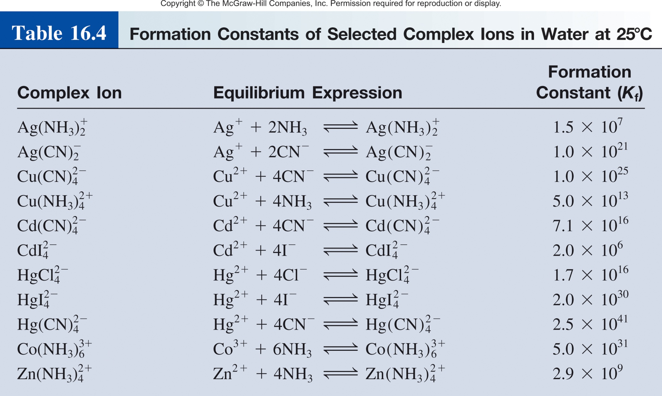
Complex Ion Equilibria
Complex Ion
Lewis acid
Lewis base

Slide 54
Complex Ion Equilibria
The formation constant (K_{f} ) is the equilibrium constant for the formation of a complex ion.
Lewis acid
Complex Ion
Ag⁺(aq) + 2NH₃(aq) Ag(NH₃)₂⁺(aq)
Lewis base
K_{f} = 1.5 x 10⁷
K_{d} = 1/K_{f}
The dissociation constant (K_{d}) is the equilibrium constant for the dissociation of the complex.
Ag(NH₃)₂⁺(aq) Ag⁺(aq) + 2NH₃(aq)
K_{d} = 6.7 x 10⁻⁸

Slide 55
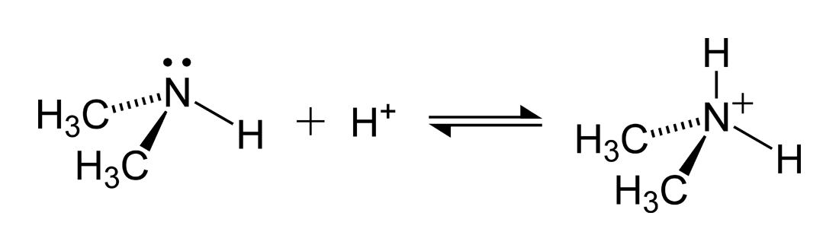
Note on Lewis Acids and Bases
A Lewis base is any species that donates an electron pair.
An Lewis acid is any species that accepts an electron pair.
This definition greatly expands the classes of acids.
A + :B ⎯→ A–B
Bronstead Acids (bases) are also Lewis acids (bases)!
Lewis base
Lewis acid
Acid-base adduct

Slide 56
Acid/Base Definitions
Arrhenius
acid is a substance that produces H⁺ in water
base is a substance that produces OH⁻ in water
Brønsted
acid is a substance that donates H⁺
base is a substance that accepts H⁺
Lewis
acid is a substance that accepts a pair of electrons
base is a substance that donates a pair of electrons

Slide 57
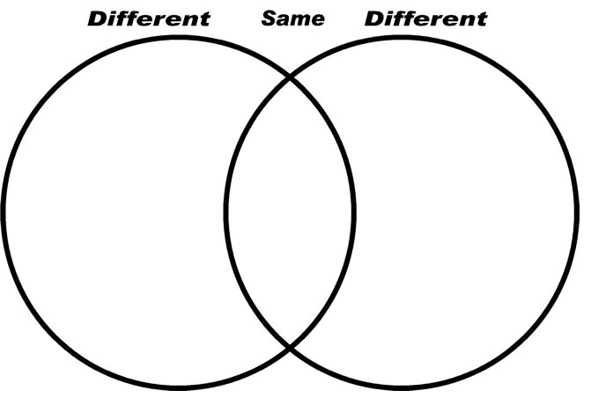
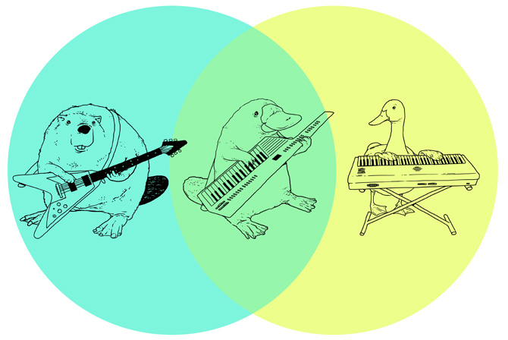
Venn Diagram

Slide 58
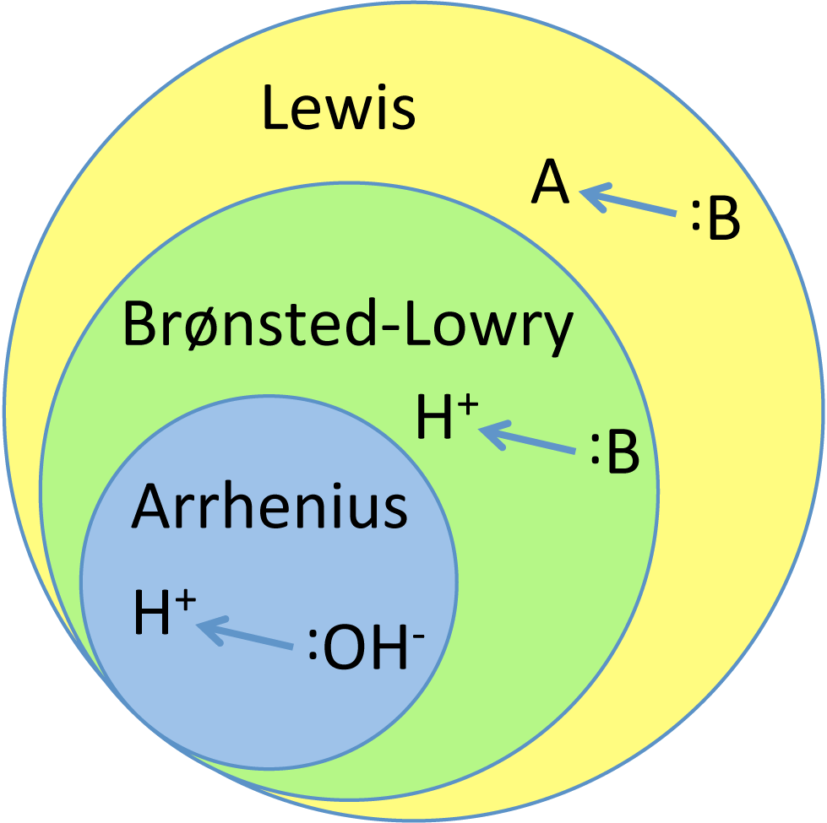
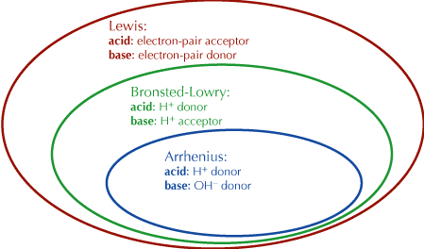
Acid/Base Venn Diagram
All Arrhenius acids are Brønsted-Lowry acids.
Not all Brønsted-Lowry acids are Arrhenius acids .
etc…

Slide 59
Solubility and pH
K_{sp} and K_{f}
Photography

Slide 60
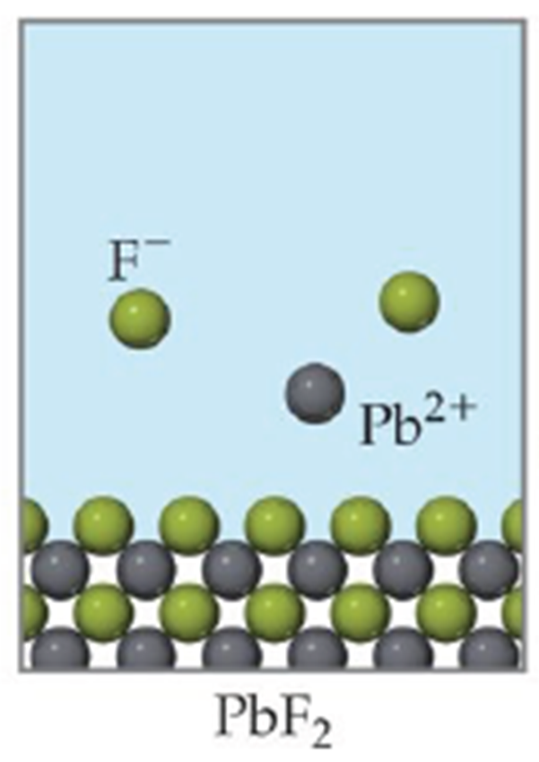
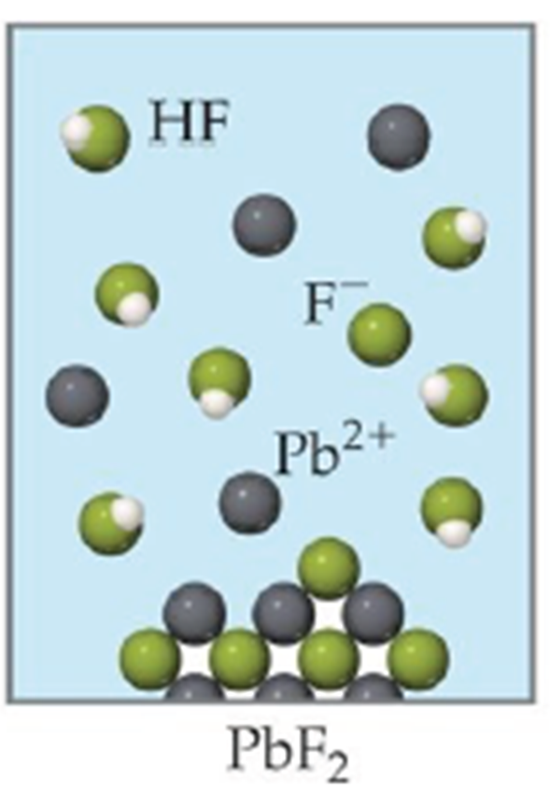
pH and Solubility
The solubility of salts that generate acidic or basic ions is influenced by the pH of the solution.
Insoluble bases dissolve in acidic solutions
Insoluble acids dissolve in basic solutions
PbF₂(s) Pb²⁺ (aq) + 2F⁻ (aq)
Add H⁺
HF(aq) H⁺ (aq) + F⁻ (aq)
Decreases

Slide 61
Which of the following compounds will be more soluble in acidic solution (H⁺) than in water:
CuS
More soluble in acid.
CuS(s) Cu²⁺(aq) + S²⁻(aq)
S²⁻(aq) + H⁺(aq) HS⁻(aq)
Decreases
(b) AgCl
Does not change.
Cl⁻ is a conjugate base of HCl.
Cl⁻ is a very weak base.
AgCl(s) Ag⁺(aq) + Cl⁻(aq)
(c) PbSO₄
More soluble in acid.
PbSO₄(s) Pb²⁺(aq) + SO₄²⁻ (aq)
SO₄²⁻(aq) + H⁺(aq) HSO₄⁻(aq)
Decreases

Slide 62
pH and Solubility
Mg(OH)₂ (s) Mg²⁺ (aq) + 2OH⁻ (aq)
Add H⁺, more soluble.
Add OH⁻, less soluble.
K_{sp} = [Mg²⁺][OH⁻]² = 1.2 x 10⁻¹¹
At pH less than 10.45
K_{sp} = (s)(2s)² = 4s³
Decrease [OH⁻], shift right
Increase solubility of Mg(OH)₂
4s³ = 1.2 x 10⁻¹¹
s = 1.4 x 10⁻⁴ M
At pH greater than 10.45
[OH⁻] = 2s = 2.8 x 10⁻⁴ M
Increase [OH⁻], shift left
pOH = 3.55 pH = 10.45
Decrease solubility of Mg(OH)₂

Slide 63
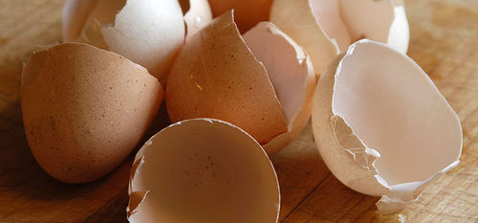
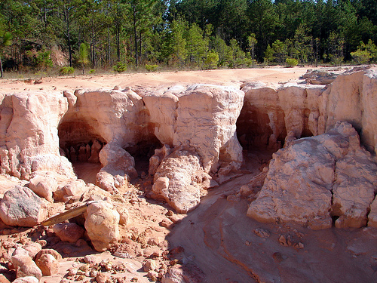
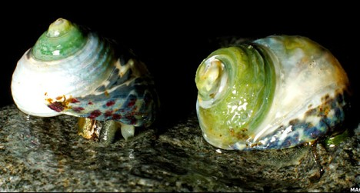
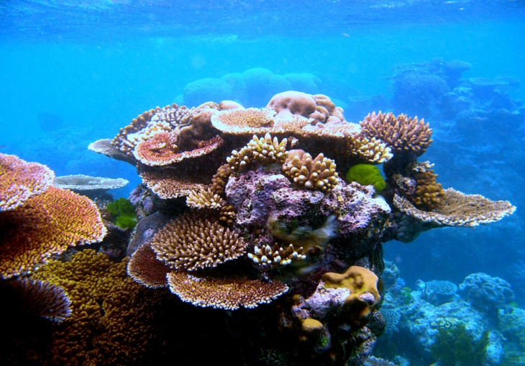
pH and Solubility
Calcium carbonate (CaCO₃)
Egg Shells
Limestone
Sea Shells
Coral Reef

Slide 64
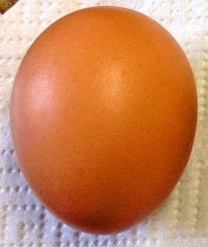



pH and Solubility
Egg
Egg in…
H⁺
K_{sp} = 8.7 x 10⁻⁹ M
Solubility increases as pH decreases.

Slide 65

Side Note: pH, Solubility, and Easter
Water
Vinegar

Slide 66
pH and Solubility
Calcium carbonate (CaCO₃)
Egg Shells
Limestone
Sea Shells
Coral Reef

Slide 67

pH and Solubility
Increasing atmospheric CO₂
Increasing atmospheric CO₂ → Ocean acidification → Dissolves CaCO₃

Slide 68




pH and Solubility

Slide 69
pH and Solubility
Calcium carbonate (CaCO₃)
Egg Shells
Limestone
Sea Shells
Coral Reef

Slide 70


pH and Solubility
Limestone
CaCO₃ becomes increasingly soluble when H⁺ is added (acid rain, ocean acidification).
60 years
60 years

Slide 71

pH and Solubility

Slide 72


pH and Solubility

Slide 73



Testable Hypothesis
Climate Change:
Increased acidity
Disrupted Water Cycle

Slide 74
Solubility and pH
K_{sp} and K_{f}
Photography

Slide 75




K_{sp} and K_{f}
K_{sp} = 1.6 x 10⁻¹⁰
1/K_{sp} = 1/7.7 x 10⁻³
AgCl(s) Ag⁺(aq) + Cl–(aq)
Ag⁺(aq) + Br–(aq) AgBr(s)
Ag⁺(aq) + NH₃(aq) Ag(NH₃)₂⁺(aq)
Ag⁺(aq) + S₂O₃²⁻(aq) Ag(S₂O₃)₂²⁻(aq)
K_{f} = 1.7 x 10⁷
K_{f} = 1.7 × 10¹³

Slide 76
Chapter 14: Multiple Equilibria
Product molecules of one equilibrium constant are involved in a second equilibrium process.
‘
[C][D]
A + B C + D
K_{c}
‘
K_{c} =
[A][B]
C + D E + F
‘
‘
K_{c}
[E][F]
‘
‘
A + B E + F
K_{c}
K_{c} =
[C][D]
[C][D]
[E][F]
[E][F]
‘
‘
K_{c}
‘
x
K_{c} =
K_{c} =
x
K_{c}
=
[A][B]
[C][D]
[A][B]
If a reaction can be expressed as the sum of two or more reactions, the equilibrium constant for the overall reaction is given by the product of the equilibrium constants of the individual reactions.

Slide 77

K_{sp} and K_{f}
AgCl_{(s)} ←→ Ag⁺ + Cl⁻ K_{sp}
Ag⁺ + 2NH₃ ←→ Ag(NH₃)₂⁺ K_{f}
AgCl + 2NH₃ ←→ Ag(NH₃)₂⁺ + Cl⁻ K = K_{sp} x K_{f}

Slide 78

Calculate the molar solubility of AgCl in a 1.0 M NH₃ solution.
[Cl⁻] = molar solubility of AgCl
AgCl_{(s)} ←→ Ag⁺ + Cl⁻
Ag⁺ + 2NH₃ ←→ Ag(NH₃)₂⁺
AgCl + 2NH₃ ←→ Ag(NH₃)₂ + Cl⁻
K_{sp} = 1.82 x 10⁻¹⁰
K_{f} = 1.7 x 10⁷
K = K_{sp} x K_{f}

Slide 79
Calculate the molar solubility of AgCl in a 1.0 M NH₃ solution.
K = 2.4 x 10⁻³
[Cl⁻] = molar solubility of AgCl
 | AgCl(s) | + 2NH₃(aq) |  | (aq) | + Cl-(aq)
Initial (M):
Change (M):
Equilibrium (M):
1.0
0.0
0.0
-s
-2s
+s
+s
1.0 – 2s
s
s

Slide 80
Solubility and pH
K_{sp} and K_{f}
Photography

Slide 81





K_{sp}, K_{f} and Photography

Slide 82




K_{sp}, K_{f} and Photography
AgBr Gel
Unless you processes it the material will continue to turn black.
AgBr(s) AgBr*(s) + Ag(s)
colorless
black

Slide 83

K_{sp}, K_{f} and Photography
The developer converts the latent image to macroscopic particles of metallic silver.
A stop bath, typically a dilute solution of acetic acid or citric acid, halts the action of the developer. A rinse with clean water may be substituted.
The fixer makes the image permanent and light-resistant by dissolving remaining silver halide. A common fixer is hypo, specifically ammonium thiosulfate.
Washing in clean water removes any remaining fixer. Residual fixer can corrode the silver image, leading to discolouration, staining and fading.

Slide 84

K_{sp}, K_{f} and Photography
The developer converts the latent image to macroscopic particles of metallic silver.
In the Devloper solution.
AgBr(s) AgBr*(s) + Ag(s)
colorless
black
Redox Chemistry.

Slide 85

K_{sp}, K_{f} and Photography
A stop bath, typically a dilute solution of acetic acid or citric acid [H⁺], halts the action of the developer. A rinse with clean water may be substituted.
After the stop bath.
Ag(s)
AgBr(s)
Use LCP to STOP the reaction
(shift the reaction left).

Slide 86
K_{sp}, K_{f} and Photography
A stop bath, typically a dilute solution of acetic acid or citric acid [H⁺], halts the action of the developer. A rinse with clean water may be substituted.
After the stop bath.
Ag(s) = completely insoluble.
Ag(s)
Under normal conditions.
AgBr(s) Ag⁺(aq) + Br⁻(aq)
AgBr(s)
K_{sp} = 5.0 x 10⁻¹³
Wash with gallons and gallons of water to remove AgBr and not Ag. Or…

Slide 87
K_{sp}, K_{f} and Photography
The fixer makes the image permanent and light-resistant by dissolving remaining silver halide. A common fixer is hypo, specifically ammonium thiosulfate.
AgBr(s) Ag⁺(aq) + Br⁻(s)
Ag(s) = completely insoluble.
Under normal conditions.
AgBr(s) Ag⁺(aq) + Br⁻(aq)
Ag⁺(aq) + S₂O₃²⁻(aq) Ag(S₂O₃)₂²⁻(aq)
K_{sp} = 5.0 x 10⁻¹³
Decreases
K_{f} = 1.7 x 10¹³
Wash with gallons and gallons of water to remove AgBr and not Ag. Or…
In the fixer solution.

Slide 88



K_{sp}, K_{f} and Photography
Washing in clean water removes any remaining fixer. Residual fixer can corrode the silver image, leading to discolouration, staining and fading.

Slide 89
K_{sp}, K_{f} and Photography
The developer converts the latent image to macroscopic particles of metallic silver.
A stop bath, typically a dilute solution of acetic acid or citric acid, halts the action of the developer. A rinse with clean water may be substituted.
The fixer makes the image permanent and light-resistant by dissolving remaining silver halide. A common fixer is hypo, specifically ammonium thiosulfate.
Washing in clean water removes any remaining fixer. Residual fixer can corrode the silver image, leading to discolouration, staining and fading.

Slide 90



K_{sp}, K_{f} and Photography
CCD and CMOS detectors.

